Slide 1
Part III – Pathway analysis using MAGMA
How do we go from genetic discoveries from GWAS/WGS/WES to mechanistic disease insight?
Danielle Posthuma

Slide 2
Practical session: Gene-set analysis using MAGMA https://ctg.cncr.nl/software/magma
Christiaan de Leeuw

Slide 3
MAGMA gene-set analysis
Software tool for gene and gene-set analysis
Command-line interface
Input
Genotype and phenotype data
Or: (full) published GWAS results (plus reference data)
Gene definitions
Gene sets

Slide 4
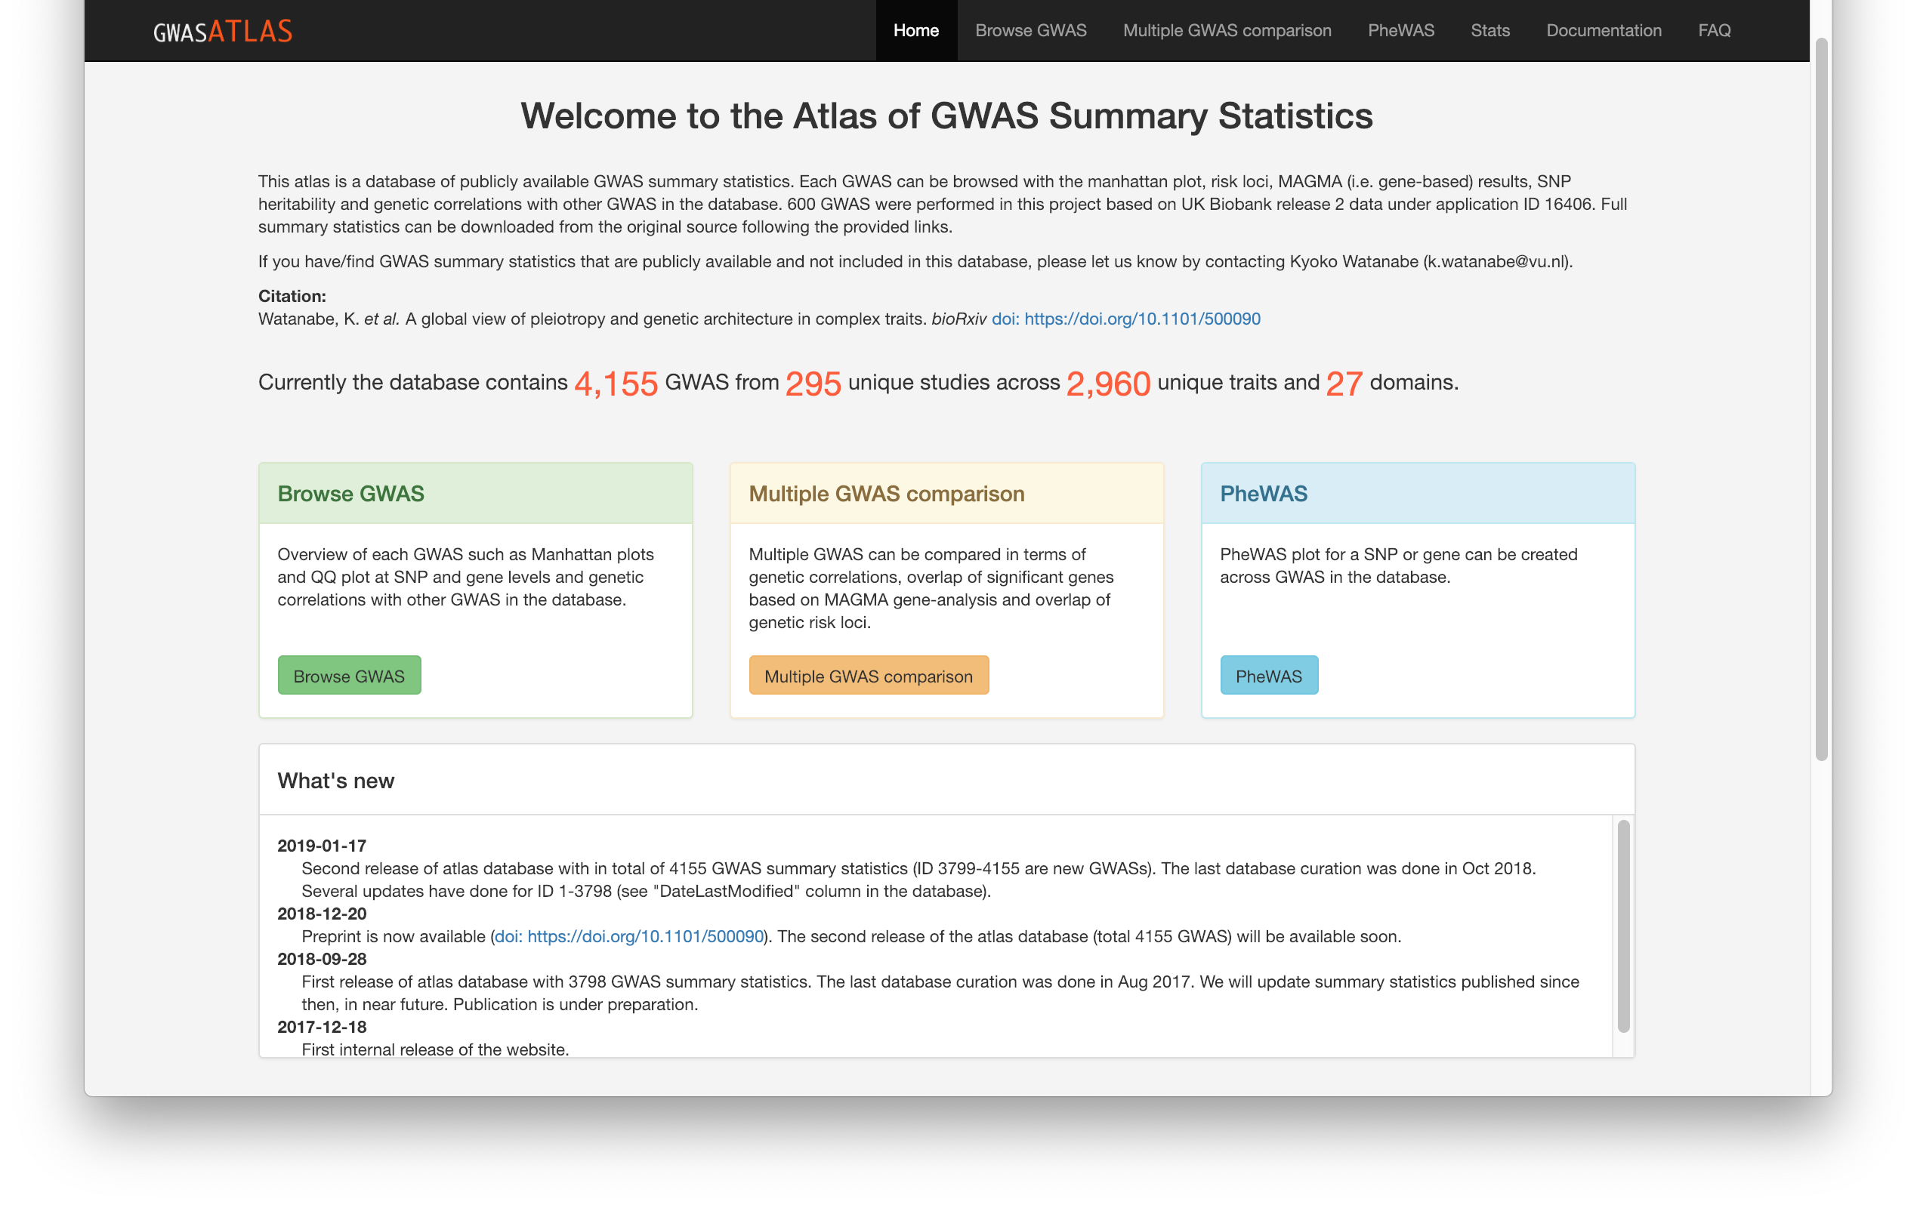
Downloading summary statistics: GWAS ATLAS
http://atlas.ctglab.nl

Slide 5
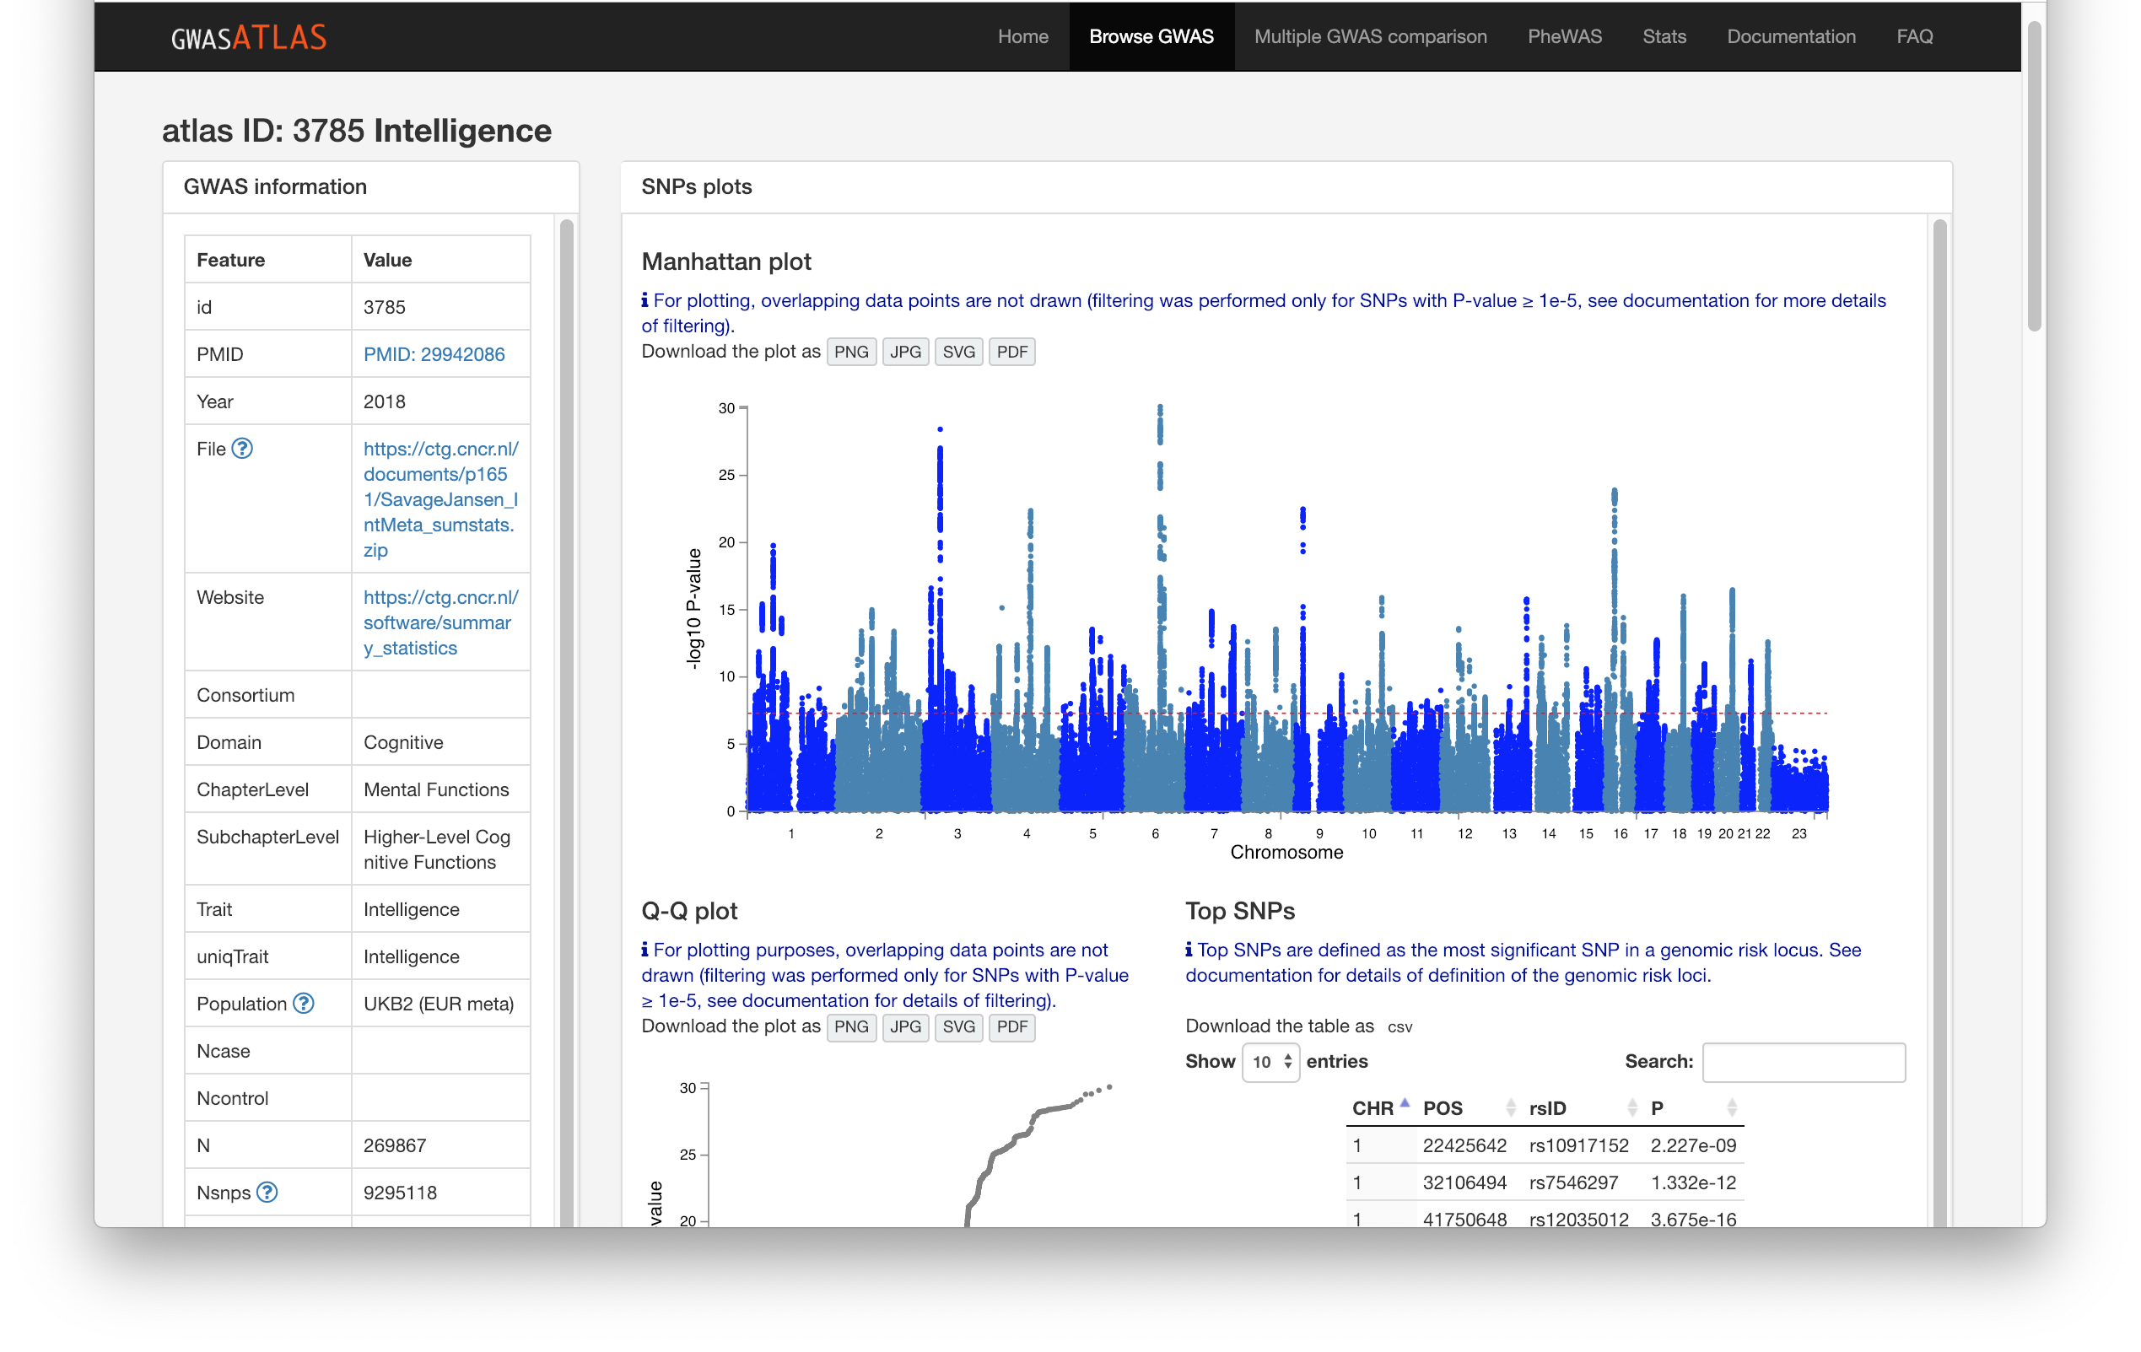
Downloading summary statistics: GWAS ATLAS
http://atlas.ctglab.nl

Slide 6
MAGMA gene-set analysis
Three main steps
Annotation: map SNPs onto genes
Gene analysis: compute association of genes with phenotype
Gene-set analysis: test gene associations in gene sets
Generalized gene-set analysis
Continuous ‘sets’
Conditional and joint analysis
Interaction analysis

Slide 7
Annotation
Map SNPs to a gene based on physical location
If located inside the transcription region of the gene
Optionally, if located in window around the gene
Especially upstream of transcription start site
A SNP can be mapped to multiple genes

Slide 8
Gene-based analysis
Four models available in MAGMA
Principal component linear regression
Performs test on explained phenotypic variance (F-test)
Requires raw genotype data
SNP-wise models: compute SNP associations with phenotype first
SNP-wise Mean: performs test on mean SNP association
SNP-wise Top: performs test on strongest SNP association
SNP-wise Multi: combines SNP-wise Top and Mean
The main question for all gene analysis: what sensitivity do you want?
Also with regard to allele frequency, functional annotation, etc.
In general, no ‘best’ or most powerful model

Slide 9
Gene-set analysis
Gene ID | Association | In gene set
1 | 1.32 | Yes
2 | -0.76 | Yes
3 | 0.48 | Yes
4 | 1.12 | Yes
5 | -0.02 | Yes
6 | -1.04 | No
7 | 0.86 | No
8 | -1.27 | No
9 | 0.41 | No
10 | 0.11 | No
An analysis of genes:
Genes are data points in the analysis
The gene set is a grouping variable
Genetic association with the phenotype is the outcome variable
So: gene-set analysis is like a t-test
Testing the mean association of genes in the gene set
One-sided test
Two kinds of t-test…

Slide 10
Gene-set analysis
Gene ID | Association | In gene set
1 | 1.32 | Yes
2 | -0.76 | Yes
3 | 0.48 | Yes
4 | 1.12 | Yes
5 | -0.02 | Yes
6 | -1.04 | No
7 | 0.86 | No
8 | -1.27 | No
9 | 0.41 | No
10 | 0.11 | No
Self-contained analysis:
Is the mean genetic association of genes in the gene set greater than 0?
$H_{0}: μ_{S}=0$
Competitive analysis:
Is the mean genetic association of genes in the gene set greater than that of genes outside the gene set?
$H_{0}: μ_{S}=μ_{0}$
$$μ_{S}$$
$$μ_{0}$$

Slide 11
Clinical study
Patient | Improvement | Treatment
1 | 1.32 | Yes
2 | -0.76 | Yes
3 | 0.48 | Yes
4 | 1.12 | Yes
5 | -0.02 | Yes
6 | -1.04 | No
7 | 0.86 | No
8 | -1.27 | No
9 | 0.41 | No
10 | 0.11 | No
Self-contained analysis:
Is the mean improvement of patients in the treatment group greater than 0?
$H_{0}: μ_{T}=0$
Competitive analysis:
Is the mean improvement of patients in the treatment group greater than that of patients in the control group?
$H_{0}: μ_{T}=μ_{C}$
$$μ_{T}$$
$$μ_{C}$$

Slide 12
Gene-set analysis
Gene ID | Association | In gene set
1 | 1.32 | Yes
2 | -0.76 | Yes
3 | 0.48 | Yes
4 | 1.12 | Yes
5 | -0.02 | Yes
6 | -1.04 | No
7 | 0.86 | No
8 | -1.27 | No
9 | 0.41 | No
10 | 0.11 | No
Self-contained analysis:
Is the mean genetic association of genes in the gene set greater than 0?
$H_{0}: μ_{S}=0$
You need a baseline or reference group to say anything about the treatment, or the gene set
$$μ_{S}$$
$$μ_{0}$$

Slide 13
Gene-set analysis
Gene ID | Association | In gene set
1 | 1.32 | Yes
2 | -0.76 | Yes
3 | 0.48 | Yes
4 | 1.12 | Yes
5 | -0.02 | Yes
6 | -1.04 | No
7 | 0.86 | No
8 | -1.27 | No
9 | 0.41 | No
10 | 0.11 | No
Competitive analysis:
Is the mean genetic association of genes in the gene set greater than that of genes outside the gene set?
$H_{0}: μ_{S}=μ_{0}$
Only competitive analysis allows any inference about the gene set itself
$$μ_{S}$$
$$μ_{0}$$

Slide 14
See you at the MAGMA practical!

